Slide 1
The Spatially-Correlative Loss for Various Image Translation Tasks (CVPR’21)
Meng Ye
10/27/2021

Slide 2
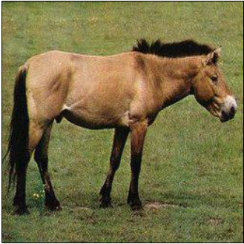
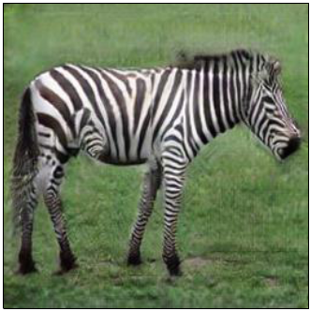
Background
Image to image translation (I2I)
Task:
(1) modify input image’s style/appearance to be the same as the target domain;
(2) preserve the original content/structure.
Horse
Zebra

Slide 3
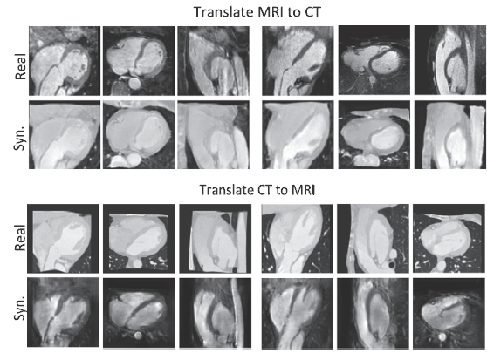
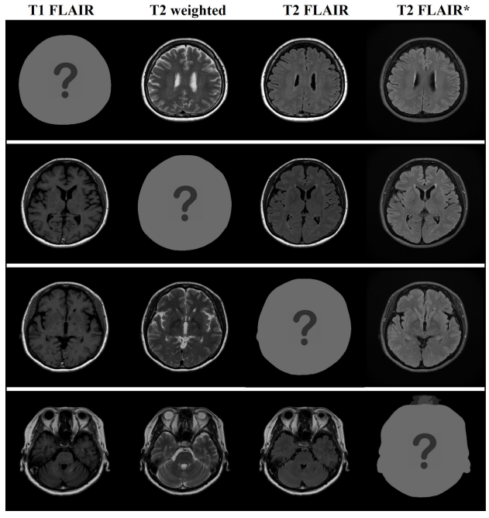
Background
I2I in medical imaging:
(1) Domain adaptation: cross modality segmentation, registration
(2) Modality completion
(1) Domain adaptation
(2) Modality completion

Slide 4
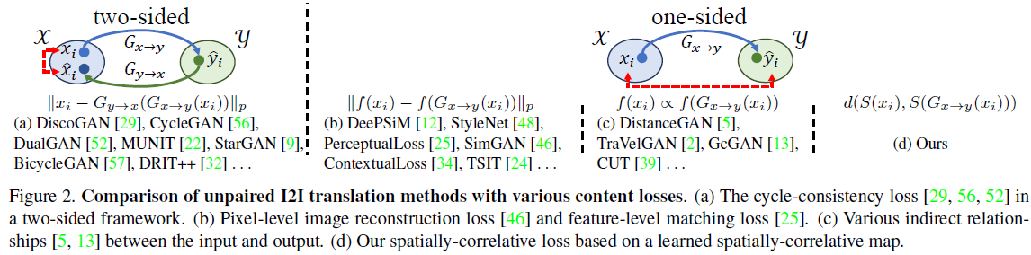
Related Work
Cycle consistency: (1) content distortion; (2) auxiliary generators and discriminators for the reverse mapping.
(b, c) Content distance loss: entangled with domain-specific features.

Slide 5
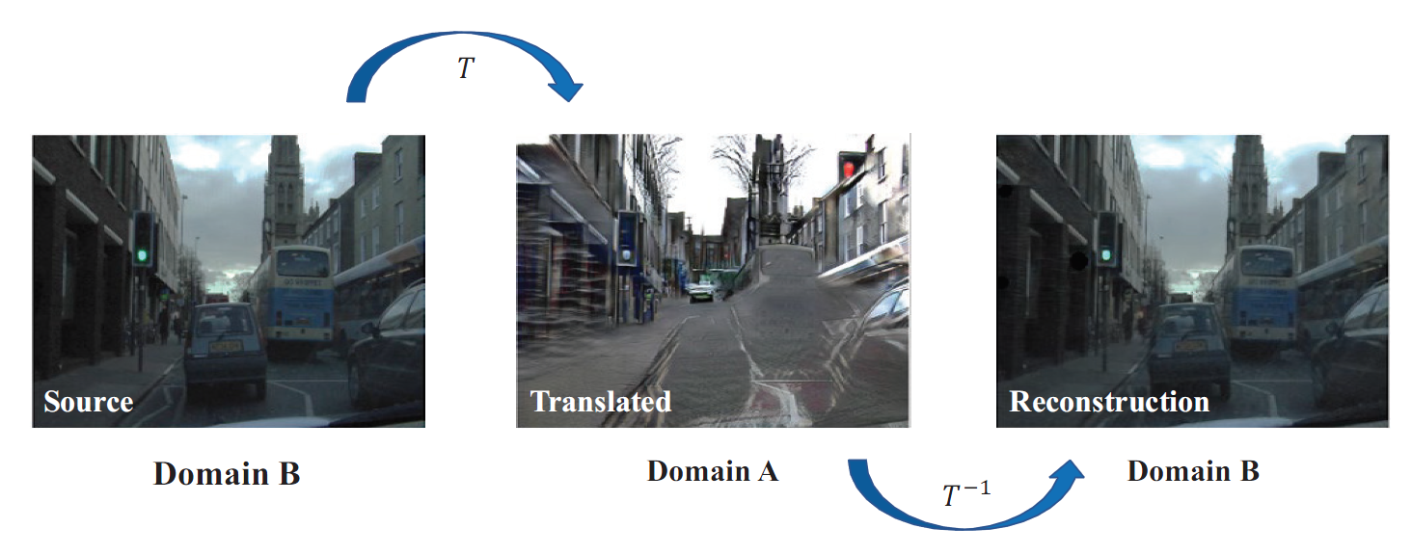
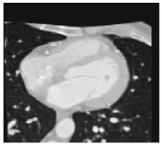
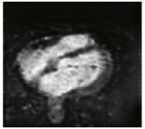
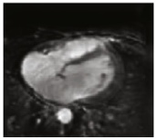
Problems
CT
Syn MRI
MRI
Content distortion
Content preserving

Slide 6
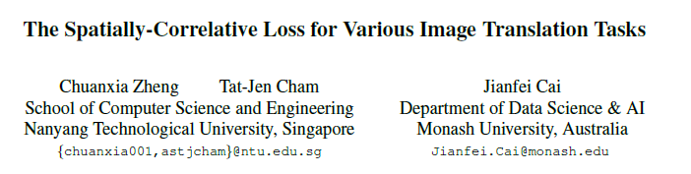
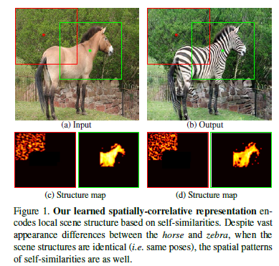

Slide 7
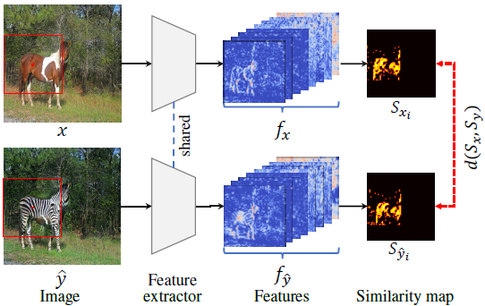
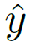
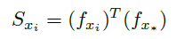
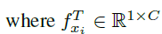
Fixed Self-Similarity
VGG16
VGG16
Extract features from the input image x and translated image
Compute local self-similarity for each query point:

Slide 8
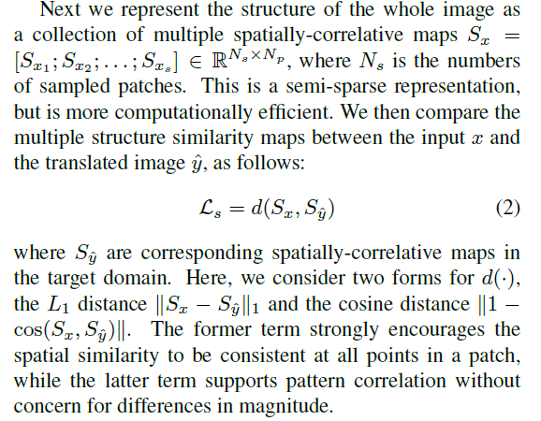
Semi-sparse representation

Slide 9
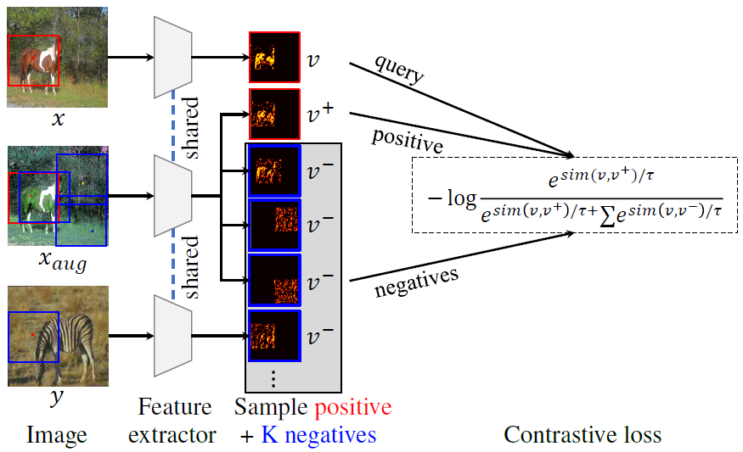
Learned Self-Similarity
To be learned !
Learn a structure representation network for each I2I task instead of using fixed pre-trained feature extractor.
Self-supervised contrastive learning that associates similar features, while simultaneously dissociates different features.
Create augmented images by applying structure-preserving transformations to give positive samples, negative samples could be patches from other positions or other images.

Slide 10
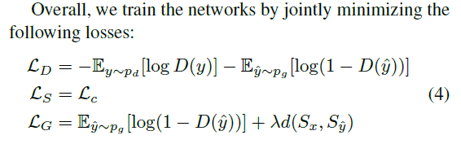
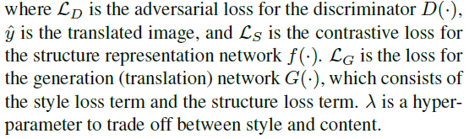
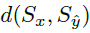
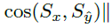
Full Objective

Slide 11
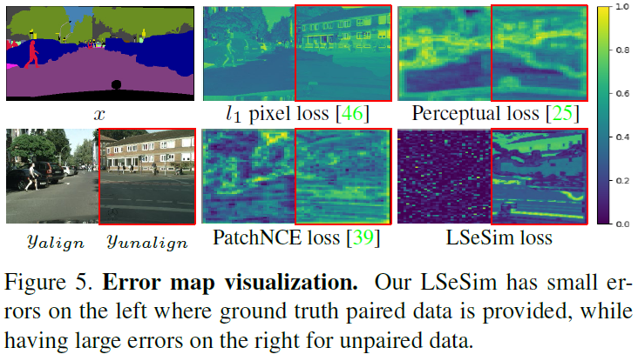
Analysis
Self-similarity deals only with spatial relationships of co-occurring signals, rather than their original absolute values.
A good content/structure loss should penalize the wrong result, while supporting the ideal result.

Slide 12
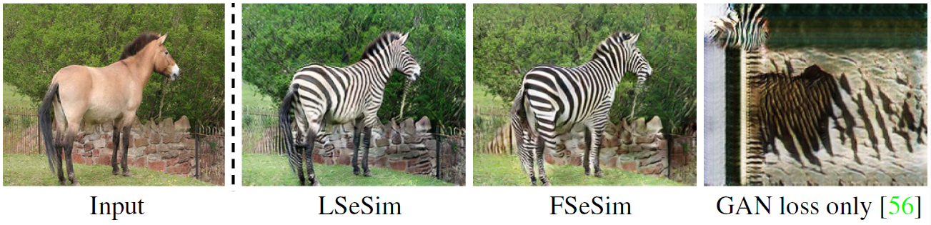
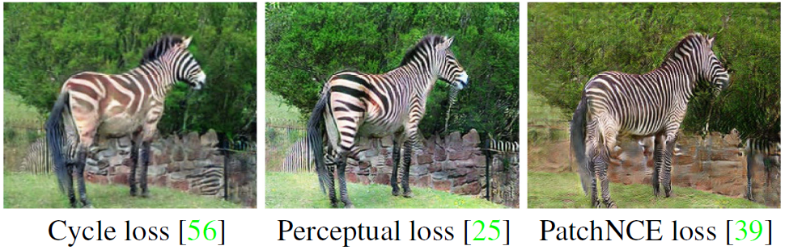
Analysis
(1) F/LSeSim is computed in a deep feature space.
(2) Represent the content/structure as multiple spatially correlative maps.
(3) Direct feature level distance loss is not free from domain-specific attributes, spatially correlative maps is more abstract that transcend domain specificity.

Slide 13
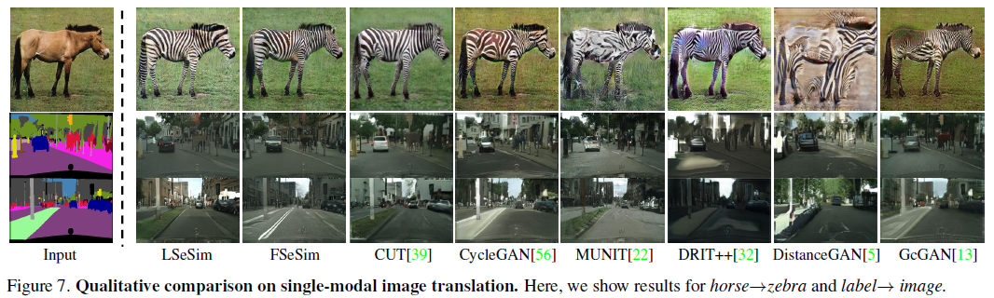
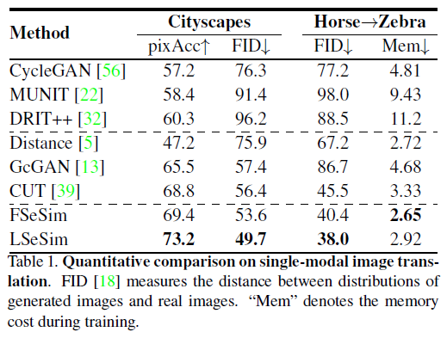
Results on Single-Modal Unpaired Image Translation

Slide 14
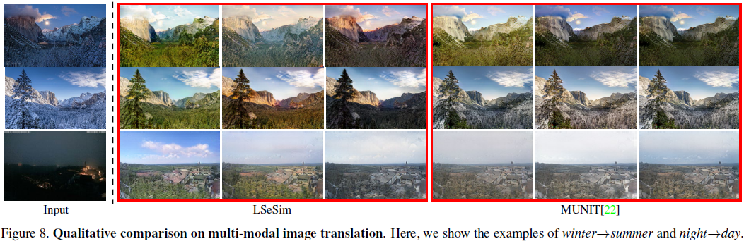
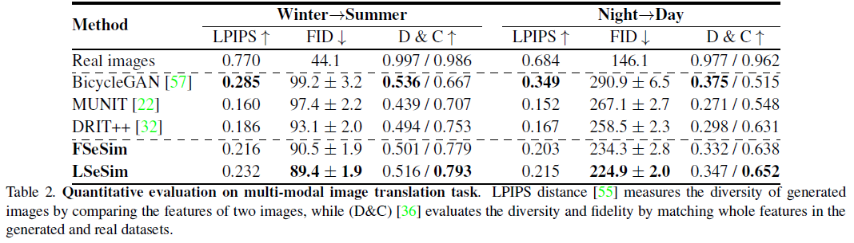
Results on Multi-Modal Unpaired Image Translation

Slide 15
Thanks a lot !

